Slide 1
The pitch
Terec Andrei
Popovici George-Ioan
Pop David

Slide 2
Problem Framing
How can we find a handyman for our house?
The handyman has the problem of not being able to easily advertise the services they can provide when not being already popular in their area.
Our solution will help them create a business profile and popularize their service locally and also help our business become a place for the non-skilled to hire an expert.

Slide 3
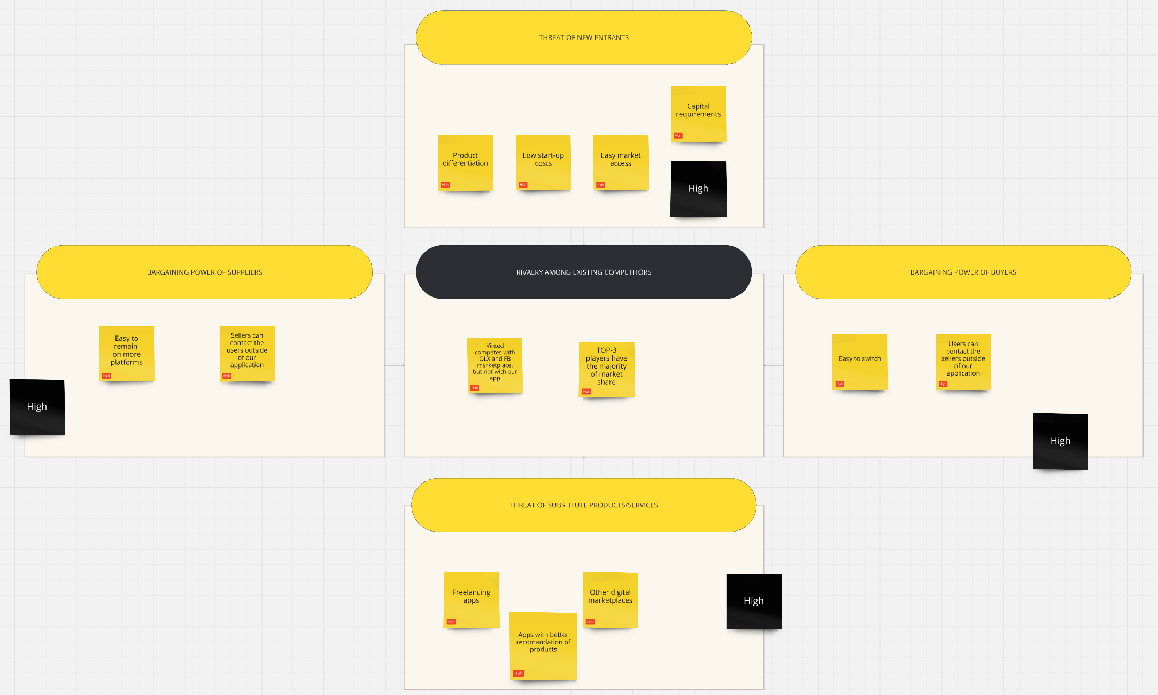
Industry and competitiveness

Slide 4
Industry and competitiveness
OLX and FB Marketplace – General marketplaces, bad at specifically providing services, but old and established with large userbases
Vinted – clothing focused marketplace, competes with OLX and FB Marketplace but not with us

Slide 5
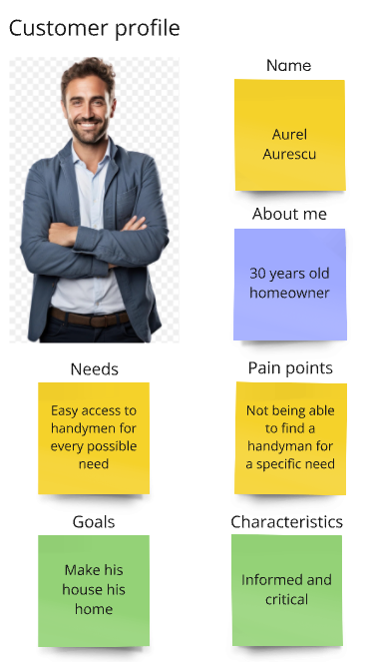
Customer profile
Needs to find handymen with expertise in various specialized tasks
Hard to find handymen in his area
Doesn’t know their prices and what is the market price for his specific job
Doesn’t know the experience of each handyman

Slide 6
What can we do for Aurel?
Create a matchmaking app so it’s easier for customers to find a handyman
Provide reviews and previous work of the handymen such that Aurel will know if they are up to his standards

Slide 7
Value proposition design - PRODUCT map
Benefits:
Easier to find handyman
Easier for handymen to find clients
Decreased the risk for customers to call an untrained handymen
Experience:
Simplified the process of asking for help from a professional
Features:
As a handyman, you can setup the region where you are willing to travel to sell your services
As a handyman, you can configure your profile with all the different jobs you are good at and you will receive ratings from customers for each job type
As a customer, I can select all types of jobs I need to have done and the application can suggest to me one or more handymen that can do my job

Slide 8
Customer need
Emotional Jobs
The customers want to feel at ease that a handyman is always available.
The customers want to feel at ease knowing that our ratings are trustworthy and crowdsourced.
Fears
Not being able to find a handyman for a specific need
Having to deal with an unexperienced handyman
Functional
Finding a handyman
and rating them

Slide 9
Procces Overview
Substitutes:
Asking someone for a recommendation of a good handyman
Searching on OLX or Facebook marketplace
Doing the job yourself
Inertia:
There aren't many handymen and they are already quite busy
Handymen are usually older and they usually don't like the switch to technology

Slide 10
Business model design
Key partners
Specific needs instead of a general purpose platform
Key activities
Bring handymen on the platform
Bring construction companies on the platform
Key propositions
Easy to find a handyman
Easy to read reviews for a handyman
Public exposure for handymen on an app specific for their needs

Slide 11
Cost structure
Development:
MVP – to release the product using free credits from cloud providers.
Marketing – Initially starting with Facebook/Reddit/Youtube/Instagram/Tiktok advertisement
Revenue Streams
We plan to earn revenue from customers paying to be in top searches.
We plan to bring customers on the platform so that companies will have reasons to pay for being advertised in top searches.

